Slide 1
An Examination of Social Protection Coverage Across Programs in Latin America Using Indicator 1.3.1.
By Ahmad Tipu

Slide 2
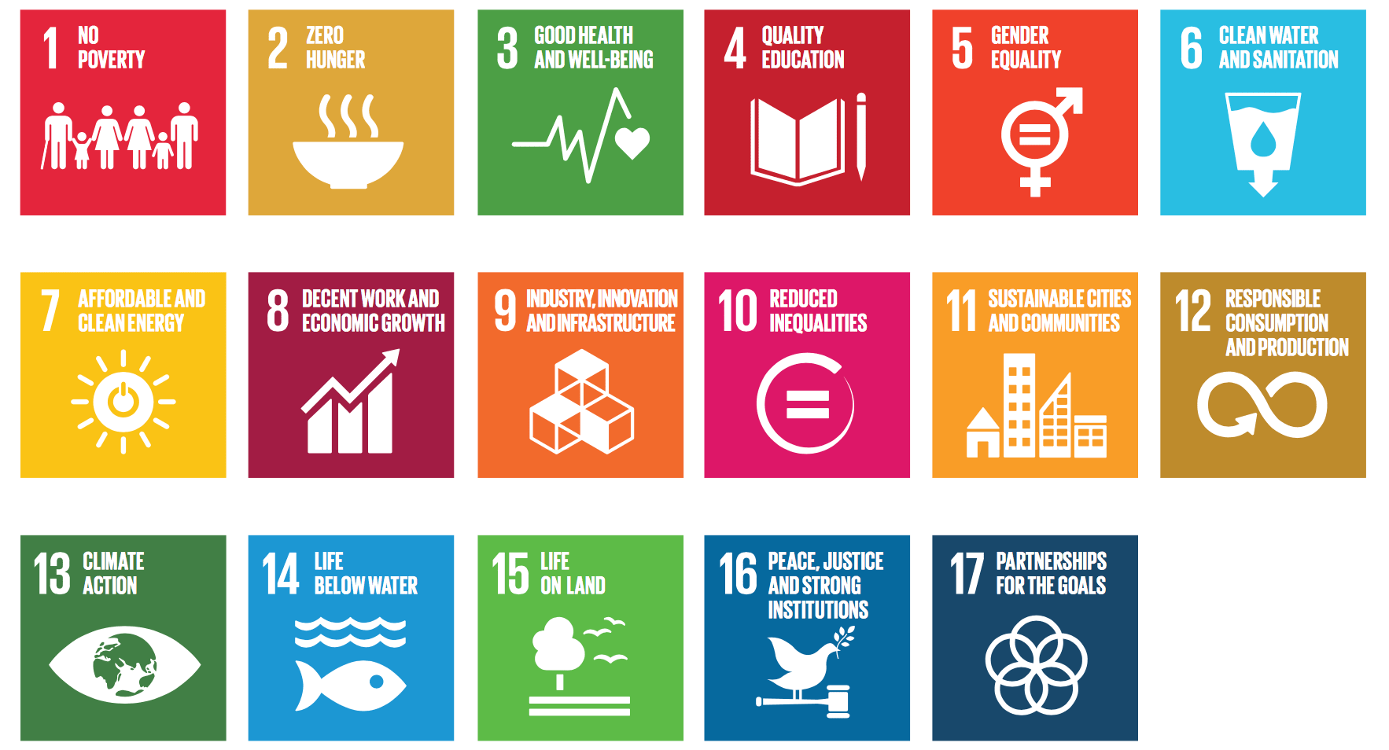
SUSTAINABLE DEVELOPMENT GOALS

Slide 3
FRAMEWORK
SDG 1
End Poverty In All Of Its Forms Everywhere
Target 1.3
Implement nationally appropriate social protection systems and measures for all, including floors, and by 2030 achieve substantial coverage of the poor and the vulnerable
Indicator 1.3.1
Proportion of population covered by social protection floors/systems, by sex, distinguishing children, unemployed persons, older persons, persons with disabilities, pregnant women, newborns, work-injury victims and the poor and the vulnerable

Slide 4

Social Protection
A set of measures in the social sphere, which allows substantial contributions to the generation of frameworks of equality, by reducing the gaps in inequality and the eradication of poverty and social exclusion

Slide 5
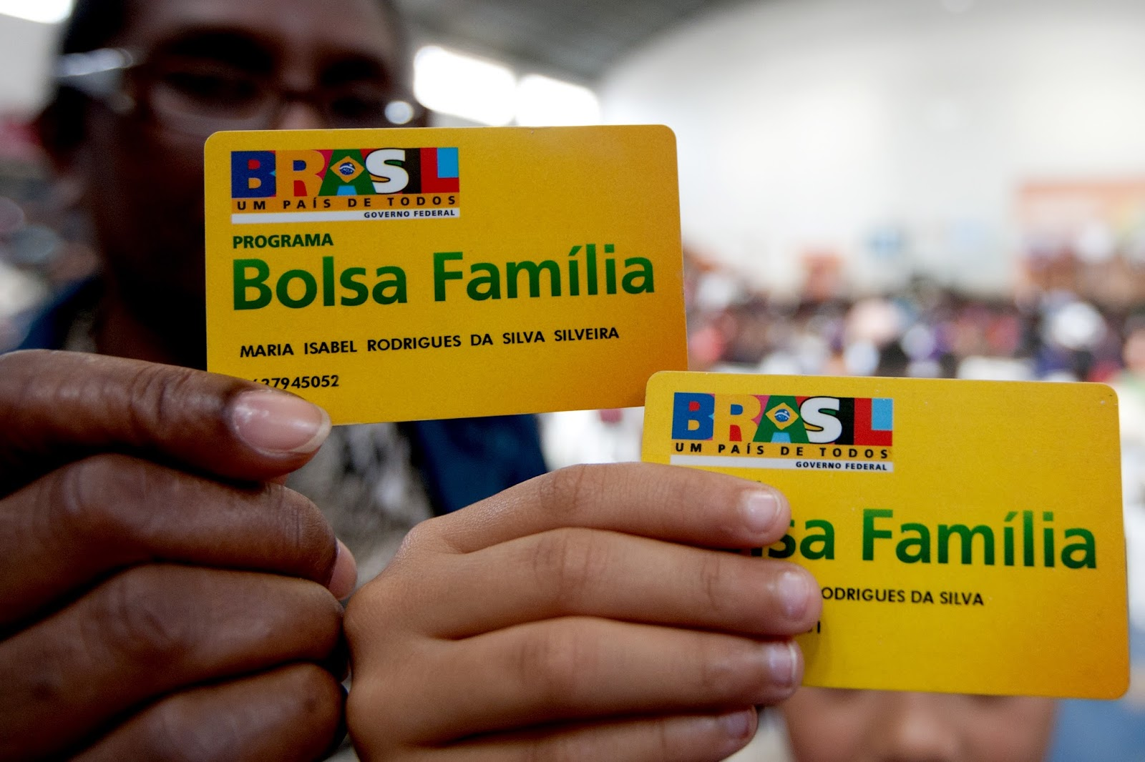
Bolsa Familia
Country: Brazil
Target Population: Families in Poverty and Extreme Poverty below national poverty line.
Combines four prior programs:
    Bolsa Escola is a program targeting education which provides cash grants to those with school-age children
    Bolsa Alimentacao aims to deal with maternal nutrition and gives cash assistance to pregnant or lactating women.
    Auxilio Gas is a cooking gas subsidy.
    Cartao Alimentacao is a specialized credit card program for use in the purchase of specific food items.
Conditions include:
    Vaccination of children who are dependants of beneficiaries
    Fulfillment of prenatal care for pregnant beneficiaries
    School enrollment and attendance for children of beneficiaries.

Slide 6

Oportunidades/Progesa
Country: Mexico
Target Population: Households below the food poverty line
Combines an education and health approach:
    Education Approach: Aims to increase familial “investment” in education.
        Offers educational grants to families so that children can attend school
        Helps subsidize cost of supplies and school related materials.
        Benefits are tied to school attendance by children.
    Health Approach: Packages services with regular checkups in state health centers.
        Provides primary health care services, cash for food support, and nutritional supplements.
        Conditional on regular visits to health service centers for checkups.

Slide 7
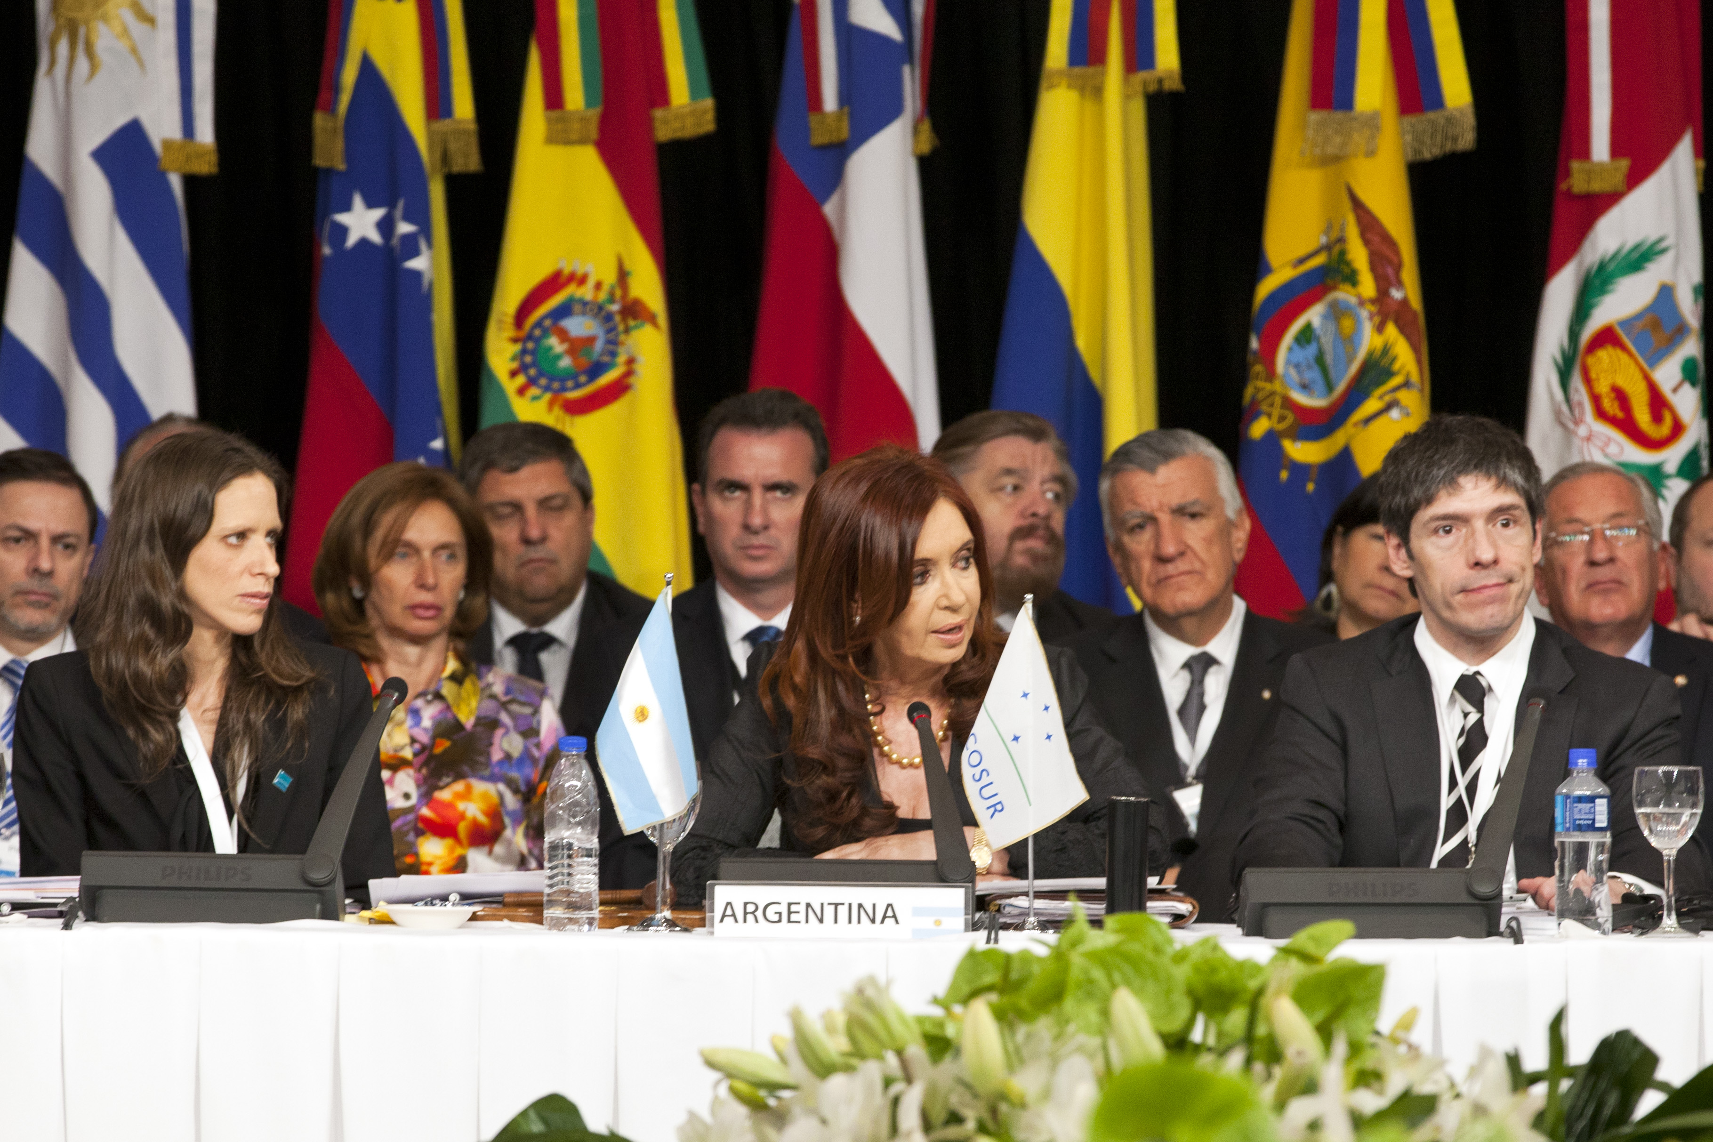
Jefas y Jefes De Hogar
Country: Argentina
Target Population: Families with unemployed heads of households with children up to age 18, disabled or pregnant women.
Created in response to early 2000’s economic crash to provide unemployed citizens a safety net while finding employment.
Provided a direct cash transfer of 150 pesos a month to beneficiaries.
Conditional upon 20 hours of work a week consisting of basic community work, training activities, or school attendance.
Aimed to culminate in transition to Familias Por La Inclusion Social when heads of household gain employment and lose qualification.

Slide 8

SOLIDARIO
Country: Chile
Target Population: Vulnerable households and individuals as per national Quality of Life Index
Uses a combination of personalized family attention and a conditional cash transfer:
    Provides social workers to families in extreme poverty so as to integrate them effectively into the network of services and programs.
    As an incentive a cash transfer is provided to those who fulfill a combination of 53 predetermined conditions for quality of life:
        Organized into categories like: Health, Education, Family dynamic, Housing, Work, and Income.

Slide 9

RED DE OPORTUNIDADES
Country: Panama
Target Population: Households in extreme poverty as per national Vulnerability Census
Focuses on investment into social capital such as the educational development of children
Bimonthly cash transfer given to female heads of household to be used for children’s development only.
Families must meet the following conditions:
    Attend pregnancy control consultations.
    Vaccinate children under 5 years.
    Guarantee school attendance by children.
    Attend all parent teacher meetings at school.
    A member of the household must participate in social capital training.

Slide 10
Methodology
I used the United Nations’ Economic Commission for Latin America and the Caribbean’s database of Non-contributory Social Protection Programs and its program profiles.
      Brazil’s Bolsa Familia, Mexico’s Oportunidades/Progresa, Argentina’s Jefas y Jefes, Chile’s Solidario, and Panama’s Red de Oportunidades.
      Contains two variables most relevant to my research, percent coverage of population expected to be eligible for each program and percent coverage of those actually eligible.
  I also used the World Bank’s Atlas of Social Protection Indicators of Resilience and Equity database which collects data on social protection indicators from international household surveys
      The variable of interest to me in this database is coverage in extreme poor (<$1.90 PPP a day) (%) - All Social Assistance.
  The main measure I used is average change in percentage over time which will indicate the general trend in coverage for each program or nation being examined.

Slide 11
DATA
Coverage (%) of Eligible Population - Solidario, Chile
2002 | 2003 | 2004 | 2005 | 2006 | 2007 | 2008 | 2009 | 2010 | 2011 | 2012 | 2013 | 2014 | 2015 | 2016 | 2017 | Average Change
1.2% | 2.6% | 4.0% | 5.4% | 6.7% | 7.7% | 8.9% | 10.1% | 11.1% | 12.3% | 13.4% | 1.9% | 0.5% | 0.1% | 0.3% | 0.3% | -0.1%
Coverage (%) of Expected to Qualify - Red de Oportunidades, Panama
2006 | 2007 | 2008 | 2009 | 2010 | 2011 | 2012 | 2013 | 2014 | 2015 | 2016 | 2017 | Average Change
3.8% | 9.2% | 11.2% | 12.2% | 11.4% | 12.1% | 11.8% | 11.6% | 11.6% | 9.9% | 9.8% | 8.2% | 0.6%

Slide 12
DATA CONTINUED
Coverage (%) of Population Expected to Qualify - Bolsa Familia, Brazil
2003 | 2004 | 2005 | 2006 | 2007 | 2008 | 2009 | 2010 | 2011 | 2012 | 2013 | 2014 | 2015 | 2016 | 2017 | 2018 | Average Change
8.8% | 15.2% | 20.8% | 25.9% | 25.8% | 24.4% | 27.8% | 27.9% | 28.4% | 28.8% | 28.4% | 27.4% | 27.1% | 26.1% | 26.4% | 26.5% | 1.2%
Coverage (%) of Population Expected to Qualify - Oportunidades/Progresa, Mexico
1997 | 1998 | 1999 | 2000 | 2001 | 2002 | 2003 | 2004 | 2005 | 2006 | 2007 | 2008 | 2009 | 2010 | 2011 | 2012 | 2013 | 2014 | Average Change
1.5% | 8.0% | 11.4% | 12.1% | 15.0% | 20.2% | 19.9% | 23.2% | 22.9% | 22.6% | 22.4% | 22.3% | 22.5% | 24.5% | 23.6% | 22.8% | 23.3% | 24.4% | 1.3%
Coverage (%) of Eligible Population - Jefas y Jefes, Argentina
2002 | 2003 | 2004 | 2005 | 2006 | 2007 | 2008 | Average Change
24.0% | 22.3% | 19.4% | 17.1% | 13.4% | 9.4% | 5.5% | -3.1%

Slide 13
DATA CONTINUED
Coverage in extreme poor (<$1.90 PPP a day) (%) - All Social Assistance
 | 2006 | 2007 | 2008 | 2009 | 2010 | 2011 | 2012 | 2013 | 2014 | 2015 | Average change
Brazil | 31.3% | - | - | - | 21.2% | 29.8% | 37.7% | 45.3% | - | - | +6.0%
Mexico | 67.0% | - | - | 24.0% | - | 28.5% | 26.0% | - | - | 76.4% | -14.8%
Argentina | 93.3% | - | - | 91.3% | - | 87.6% | - | 89.8% | - | - | -1.2%
Chile | - | - | 55.0% | - | 78.9% | - | 74.5% | - | - | - | +9.8%
Panama | - | - | 75.9% | 85.4% | 89.2% | 83.4% | 86.7% | 84.4% | 81.7% | - | +1.0%

Slide 14
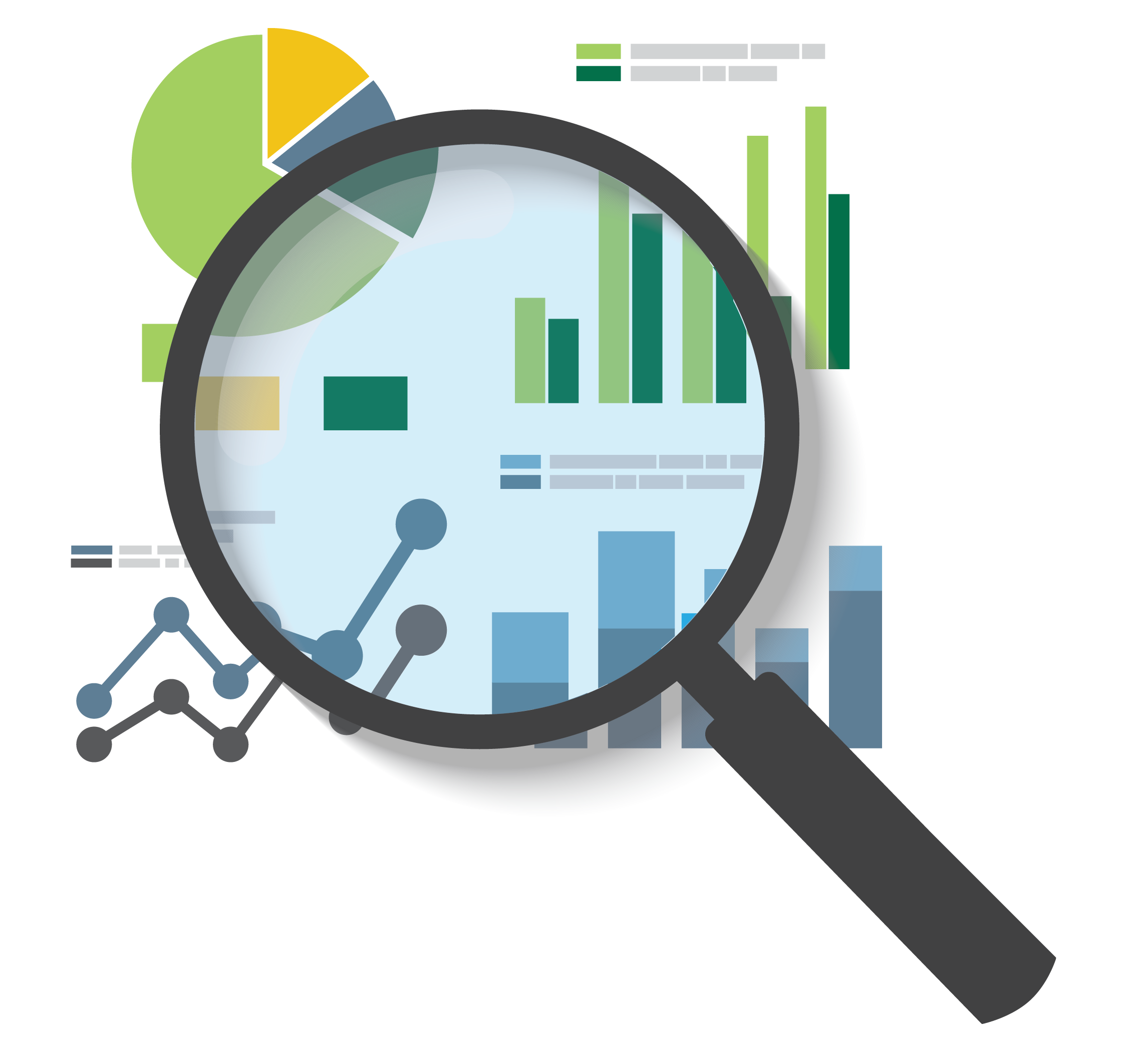
Observations
World Bank Atlas of Social Protection Dataset – Average Change in Coverage in extreme poor (<$1.90 PPP a day)
    Brazil: +6.0% (2006-2013)
    Mexico: -14.8% (2006-2015)
    Argentina: -1.2% (2006-2013)
    Chile: +9.8% (2008-2012)
    Panama: +1.0%
United Nations’ Economic Commission for Latin America and the Caribbean - Percent Coverage of Those Expected to be Eligible/Actually Eligible
    Brazil’s Bolsa Familia: +1.2% (2003-2018)
    Mexico’s Oportunidades/Progresa: +1.3% (1997-2014)
    Argentina’s Jefas Y Jefes: -1.3% (2002-2008)
    Chile’s Solidario: -0.1% (2002-2017)
    Panama’s Red de Oportunidades: +0.6% (2006-2017)

Slide 15

CONCLUSION
Using coverage is at best too rough a measure to determine achievement of SDG1:
    For many integrated anti-poverty programs their full impact is not covered by a measure relying on an older definition of poverty.
    A full econometric analysis would do better in capturing the full range of social protection impact in alleviating poverty.
When looking at the changes in coverage by specific programs the movement is minimal and does not offer enough to make a judgment on.
    There needs to be a universal level of coverage agreed upon and operationalized within the SDGs.
The range of disaggregation offered by Indicator 1.3.1 is not covered by the sparse data offered by the UN, World Bank, ILO and others
Many member states use their own indicators, indexes, and surveys rather than the World Bank defined less than $1.90 per day to define extreme poverty.
    There needs to be a universally agreed upon line by which to define extreme poverty in these programs.

